Slide 1
Software Project Selection Methods

Slide 2
‘Step Wise’ - an overview
0.Select
project
1. Identify
project objectives
2. Identify project
infrastructure
3. Analyse
project
characteristics
Review
4. Identify products
and activities
5. Estimate effort
for activity
Lower
level
detail
For each
activity
6. Identify activity
risks
10. Lower level
planning
7. Allocate
resources
9. Execute plan
8. Review/ publicize
plan

Slide 3
Selection of project
Technical Assessment
  Technical Assessment of a proposed system consists of evaluating the required functionality against the hardware/software available.
Cost benefit analysis
  Most common way of carrying out an economic assessment of a proposed system is by comparing the expected costs of development and operation of the system with the benefits of having it in place

Slide 4
Cost benefit analysis
it is usually necessary to ask whether or not the project under consideration is the best of a number of options
  There might be more candidate projects than can be undertaken at any one time and, in any case, projects will need to be prioritized so that any limited resources may be allocated effectively.
Standard way of evaluating the economic benefits of any project is to carry out a cost benefit analysis, which consists of two steps.
  Identifying and estimating all of the costs and benefits of carrying out the project and operating the system.
    These include the development costs of the system, the operating costs and the benefits that are expected to accrue from the operation of the new system.
  Expressing these costs and benefits in common units
    We need to evaluate the net benefit, that is, the difference between the total benefit accruing from the system
Notes:
Gradual increase of benefits, investment

Slide 5
CBA
It is helpful to categorize costs according to where they originate in the life of the project.
  Development costs:
    Include the salaries and other employment costs of the staff involved in the development project and all associated costs.
  Setup costs:
    Include the costs of putting the system into place.
      These consist mainly of the costs of any new hardware and additional equipment, but will also include costs of file conversion, and staff training.
  Operational costs:
    Consist of the costs of operating the system once it has been installed.

Slide 6
CBA Evaluation Techniques
Consider proceeding with a project only where the benefits outweigh the costs.
Decide on a consistent and standardized approach for measuring benefits for the criteria.
  For instance, for financial return you could use one or more of the following:
    Net Profit
    Payback period
    Net present value (NPV)
    Return on investment (ROI)
    Internal rate of return (IRR)
    Other forms of cost/benefit analysis
Notes:
a financial gain, especially the difference between the amount earned and the amount spent in buying.

Slide 7
Net Profit
Net profit
  The net profit of a project is the difference between the total costs and the total income over the life of the project.
  Net profit = Total income – Total costs
    Advantage: simple to use
    Disadvantage: ignores the timing of the cash flow

Slide 8
Financial Return methods
Payback period
  Payback period is the amount of time it takes a company to regain its initial investment in the cost of producing a product or service.
  Payback period = Time taken to pay back the initial investment
    Advantage: simple to calculate, not sensitive to small forecasting errors
    Disadvantage: ignores any income (or expenditure) after the payback period
Notes:
profit from an investment equal to the initial outlay.

Slide 9


Time Value of Money
A Dollar sitting in your wallet is worth more today than the same dollar tomorrow.
Can you tell Why?
Depreciation.
Money grows over time when it earns interest.
So, the time value of money brings us to the concept of
  Future Value of Money
  Present Value of Money

Slide 10
Present Value
Present value states that an amount of money today is worth more than the same amount in the future.
In other words, present value shows that money received in the future is not worth as much as an equal amount received today.
Receiving $1,000 today is worth more than $1,000 five years from now. Why?
  An investor can invest the $1,000 today and probably earn a rate of return over the next five years. Present value takes into account any interest rate an investment might earn.

Slide 11
Discount Rate for Finding Present Value
The discount rate is the relevant interest rate that mathematically increases future value in nominal or absolute terms.
Notes:
Small
Complete
the nominal value of something does not factor in market conditions. In economics, the nominal value of something is its current price; the real value of something, however, is its relative price over time. The real value considers inflation.

Slide 12
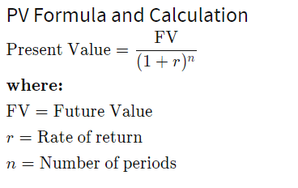
PV Formula and Calculation
Present Value

Slide 13
STEPS
Input the future amount that you expect to receive in the numerator of the formula.
Determine the interest rate that you expect to receive between now and the future and plug the rate as a decimal in place of "r" in the denominator.
Input the time period as the exponent "n" in the denominator. So, if you want to calculate the present value of an amount you expect to receive in three years, you would plug the number three in for "n" in the denominator.

Slide 14
Future Value
Future value (FV) is the value of a current asset at a specified date in the future based on an assumed rate of growth.
Present value (PV) is the current value of a future sum of money or stream of cash flows given a specified rate of return. Present value takes the future value and applies a discount rate or the interest rate that could be earned if invested.
  Future value tells you what an investment is worth in the future while the present value tells you how much you'd need in today's dollars to earn a specific amount in the future.

Slide 15
Present value intra-year discounting
Problem 1: Present value intra-year discounting
What is the present value of $1,000 received in two years if the interest rate is?
(a) 12% per year discounted annually
Solution:
1,000 / (1 + 0.12) ²
Answer: $797.19
Notes:
Refers to processes which occur on a time scale of less than 1 year but more than 1 month.
Within
The value of lump sum amount (one time cash flow) at present time evaluated at a given interest rate assuming that discounting take place more than one time in a year (Intra-year).

Slide 16
b) 12% per year discounted semi-annually
Solution:
1,000 / (1 + 0.12/2) ^{2*2}
Answer: $792.09
(c) 12% per year discounted daily
Solution:
1,000 / (1 + 0.12/365) ^{2*365}
Answer: $786.66
Notes:
Twice a year

Slide 17
Present value of a single amount
Problem 2: Present value of a single amount
You have just won a $1 million lottery. This new lottery, however, will pay out the award 60 years from today. What is the present value of your award based on a 16% p.a. interest rate?
Solution:
1,000,000 / (1 + 0.16) ⁶⁰
Answer: $135.68

Slide 18
Using present value formula
Problem 3: Using present value formula
$7,000 for 10 years from now at 7% is worth how much today?
Solution:
7,000 / (1 + 0.07) ¹⁰
Answer: $3,558.45

Slide 19
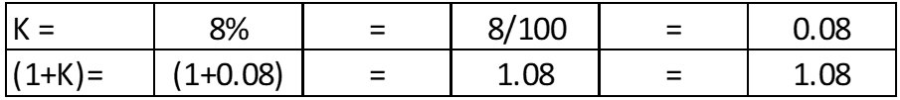
Calculate the Future Value
Example: If $ 100 dollars is invested in a bank today may earn 8% per year. what is the future value of the $ 100 dollars for 1st, 5th and 15th year?
FV = PV (1 + r)^{n}
PV = 100
n = 1
n = 5
n = 15
K=r = 8%
FV = ? When n =1, n=5, n=15
After 1 year(n=1): FV = 100 X (1.08)¹ = 100*1.08 = $108
After 5 years (n=5): FV = 100 X (1.08)⁵ = 100*1.08*1.08*1.08*1.08*1.08 = $146.93
After 15 years (n=15): FV = 100 X (1.08)¹⁵ = $317.22

Slide 20
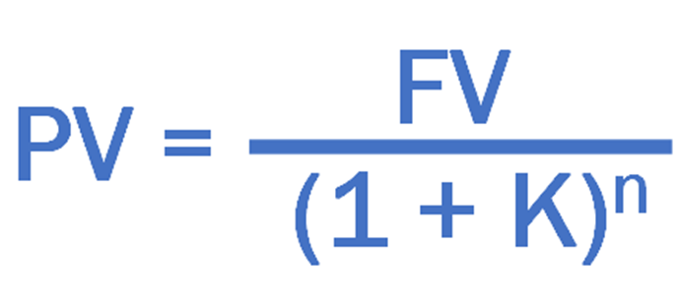
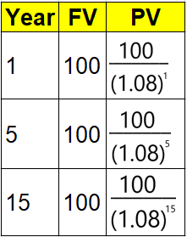
Calculate the Present Value
Example
If $ 100 dollars is to be received after 1 year, what is the present value of $100 dollars today?
If $ 100 dollars is to be received after 5 years, what is the present value of $100 dollars today?
If $ 100 dollars is to be received after 15 years, what is the present value of $100 dollars today?
Note: Discounted rate is 8% per year.
FV = 100
n = 1
n = 5
n = 15
K = 8%
PV = ? for n =1, n=5, n=15
The Present value of $ 100 to be received after 1 year is $93 dollars today.
The Present value of $ 100 to be received after 5 years is $68 dollars today.
The Present value of $ 100 to be received after 15 year is $32 dollars today.

Slide 21
Net Present Value Analysis
Net Present Value (NPV) = “Present Value of all cash inflows – Present Value of all cash outflow”
Example: Salary Slip
Net Salary = Gross Salary – Deductions
Similarly, The Present Value of all cash inflows is the Gross Present Value
and if you deduct cash outflows it becomes your Net Present Value.
  Projects with a positive NPV should be considered if financial value is a key criterion. The higher the NPV, the better
If | It means | Then
NPV > 0 | the investment would add value to the firm | the project should be accepted
NPV < 0 | the investment would subtract value from the firm | the project should be rejected
NPV = 0 | the investment would neither gain nor lose value for the firm | the project could be accepted as this project adds no monetary value. Decision should be based on other criteria, e.g. strategic positioning.

Slide 22

Example1: Calculating NPV
A sum of $ 400,000 dollars invested today in an IT project may give a series of below cash inflows in future:
$ 70,000 in year 1
$ 120,000 in year 2
$ 140,000 in year 3
$ 140,000 in year 4
$ 40,000 in year 5
If Opportunity cost of capital is 8% per annum, then should we accept or reject the project?
Solution:
Step 1: Calculate the PV value of year 1, year2, year3, year4, and year5
Step 2: Sum up the PV of all years
Step3: NPV = Present value of all cash inflows – Present value of all cash outflow.
Step 4: If NPV is positive, Accept the project, if not Reject the project.

Slide 23

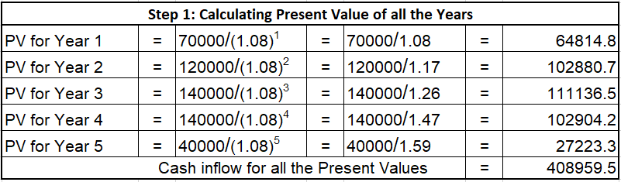
Cash Inflow of all Present Values is : $ 408,959
Present value of Cash outflow is : $400,000
Net Present Value = PV of Cash inflows – PV of Cash Outflows = ($408959 – $400000) = $8959 dollars.
Since NPV is positive, (i.e., $8959, This project can be accepted)
Example1: Calculating NPV

Slide 24
Example2: Calculating NPV
Same example: Calculating NPV however with Discount rate or Opportunity cost of capital at 15%
A sum of $ 400,000 dollars invested today in an IT project may give a series of below cash inflows in future:
$ 70,000 in year 1
$ 120,000 in year 2
$ 140,000 in year 3
$ 140,000 in year 4
$ 40,000 in year 5
If Opportunity cost of capital is 15% per annum, then should we accept or reject the project?
Solution: Calculating NPV
Step 1: Calculate the PV value of year 1, year2, year3, year4, and year5
Step 2: Sum up the PV of all years
Step3: NPV = Present value of all cash inflows – Present value of all cash outflow.
Step 4: If NPV is positive, Accept the project, if not Reject the project.

Slide 25
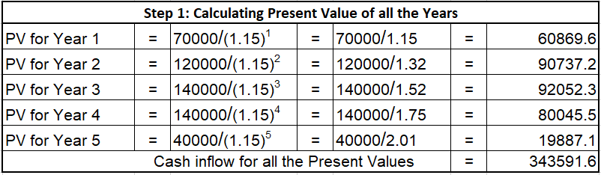
Example2: Calculating NPV
N.B: Though we have the same inflow & outflow of cash as in the previous example, the NPV value changed with the change in the Discount rate of interest.
Therefore, NPV is very much dependent on the Discount rate.
Cash Inflow of all Present Values is : $ 343591
Present value of Cash outflow is : $400,000
Net Present Value = PV of Cash inflows – PV of Cash Outflows =($343591 – $400000) = $ -56408 dollars.
(negative 56408 dollars)
Since NPV is Negative, (i.e., - $56408, This project should be rejected)

Slide 26
Financial Return methods
NPV
  Advantage:
  It considers time value of money.
    Considers the profitability of a project and the timing of the cash flows that are produced.
  Disadvantage:
      1. hard to select an appropriate discount rate
      2. NPV only takes into account the cash inflows and outflows of a particular project. It does not consider any hidden costs, sunk costs, or other preliminary costs incurred about the specific project. Therefore, the profitability of the project may not be highly accurate.
Notes:
sunk cost, in economics and finance, a cost that has already been incurred and that cannot be recovered.

